Slide 1
10-1. Ensemble
Youngsoo Kim <pineland@hanmail.net>
Code : https://github.com/pineland/AIDA/

Slide 2
Contents
What is a Ensemble?

Slide 3
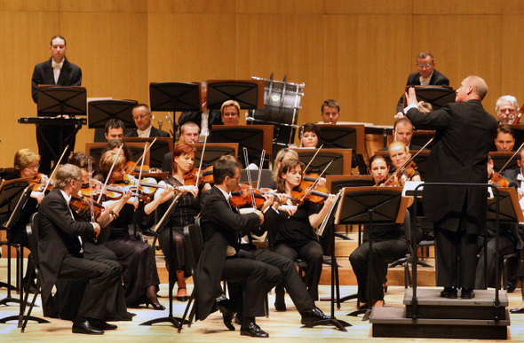
What is a Ensemble?

Slide 4
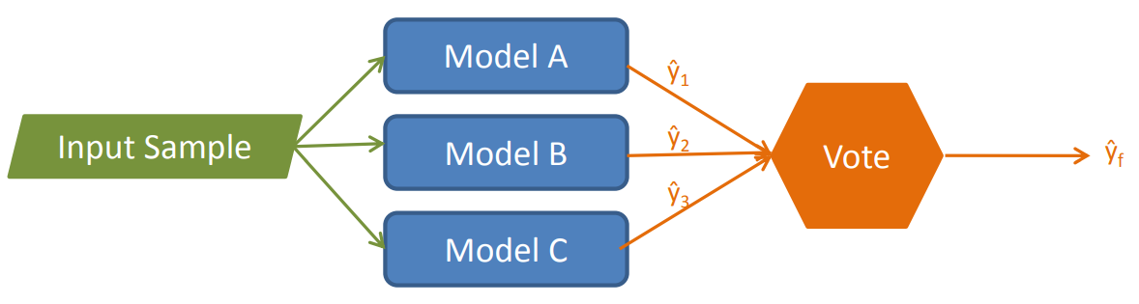
What is a Ensemble?
A combination of multiple and diverse models
  Also called “model combining”
Each model makes a prediction, then the final prediction is determined by a majority vote among the models.

Slide 5
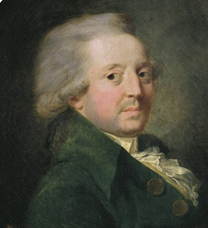
Background
The theory behind Ensemble method is based on a seminal paper written by Marquis de Condorcet, the French mathematician, in 1785.
In the paper, he proposed a mathematical reasoning behind majority voting in jury systems on the probability that a jury will come to the correct decision.
* Essay on the Application of Analysis to the Probability of
Majority Decisions
https://en.wikipedia.org/wiki/Condorcet%27s_jury_theorem

Slide 6

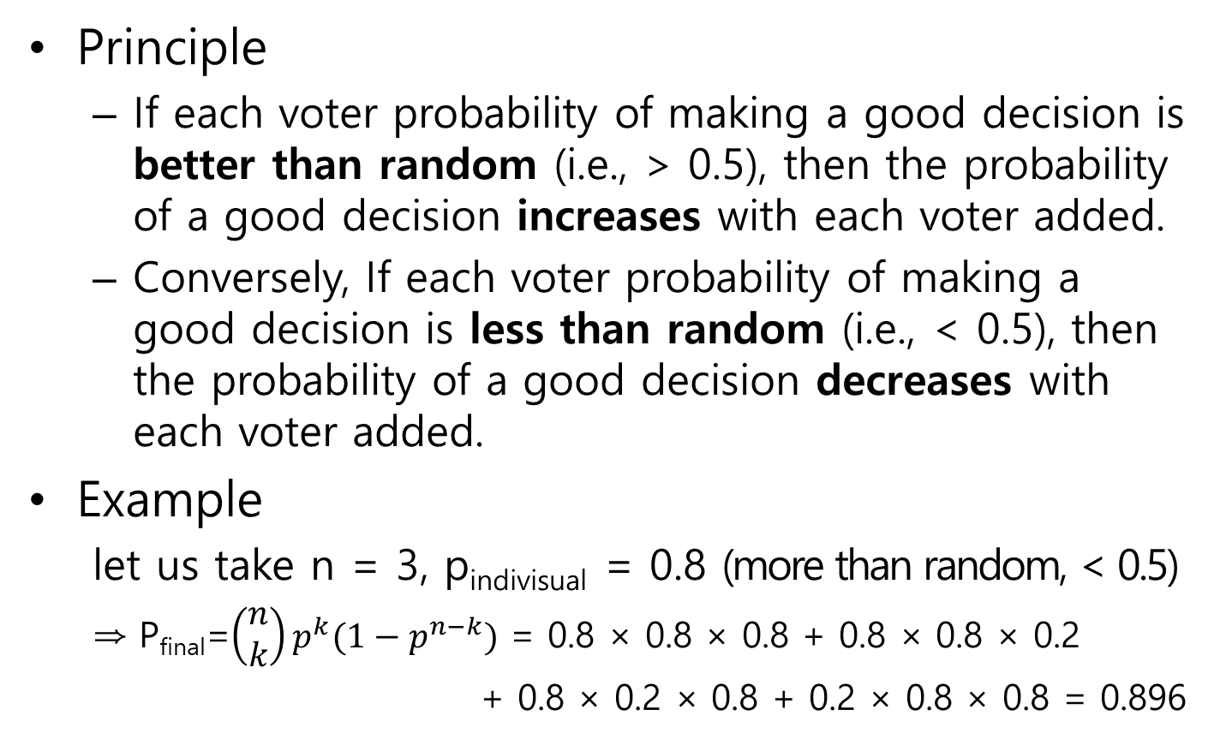
Condorcet’s Jury Theorem
Principle
  If each voter probability of making a good decision is better than random (i.e., > 0.5), then the probability of a good decision increases with each voter added.
  Conversely, If each voter probability of making a good decision is less than random (i.e., < 0.5), then the probability of a good decision decreases with each voter added.
Example
  let us take n = 3, p_{indivisual} = 0.8 (more than random, < 0.5)
  ⇒ P_{final}=$\left(\begin{matrix}n \\ k\end{matrix}\right)p^{k}(1−p^{n−k})$ = 0.8 × 0.8 × 0.8 + 0.8 × 0.8 × 0.2
  + 0.8 × 0.2 × 0.8 + 0.2 × 0.8 × 0.8 = 0.896

Slide 7
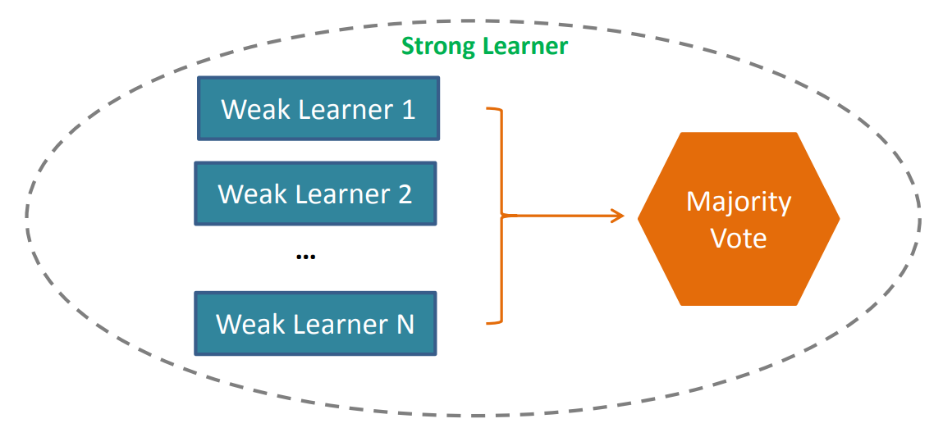
Weak learner vs. Strong learner
Weak learner : Individually trained model
Strong learner

Slide 8
Taxonomy of Ensemble learning
Aggregation
  Collect and uses weak learners defined in advance.
  (Majority) Voting, bagging, pasting, random forest, etc.
Boosting
  Make strong learners by connecting weak learners gradually one by one.
  Ada Boost, Gradient Boost

Slide 9
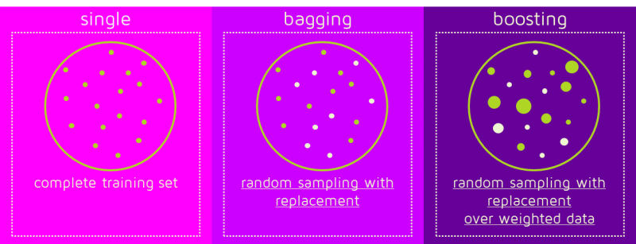
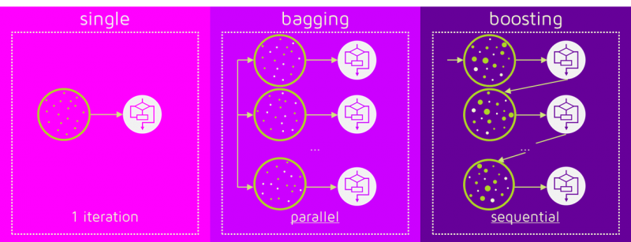
Dataset
Process formation

Slide 10
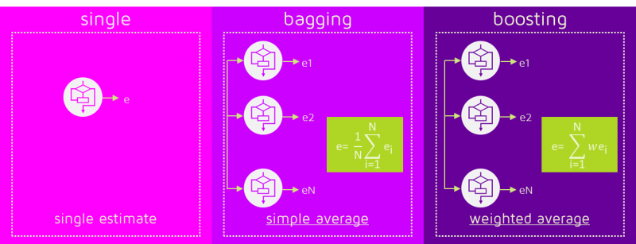
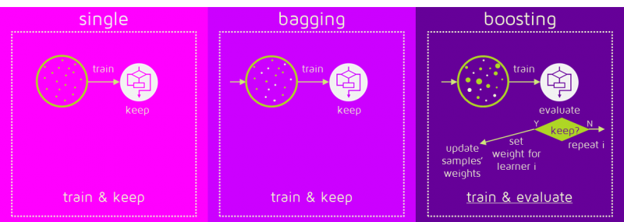
Classified error weight
Iteration condition

Slide 11
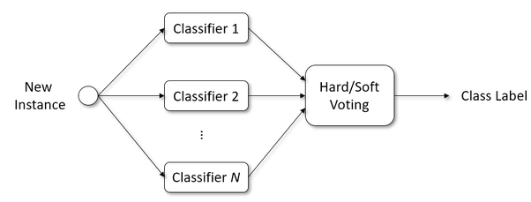
(Majority) Voting
Hard voting
  The final result is obtained through majority voting with the predicted labels of all classifiers.
Soft voting
  The final result is obtained through majority voting with the predicted probabilities of all classifiers

Slide 12
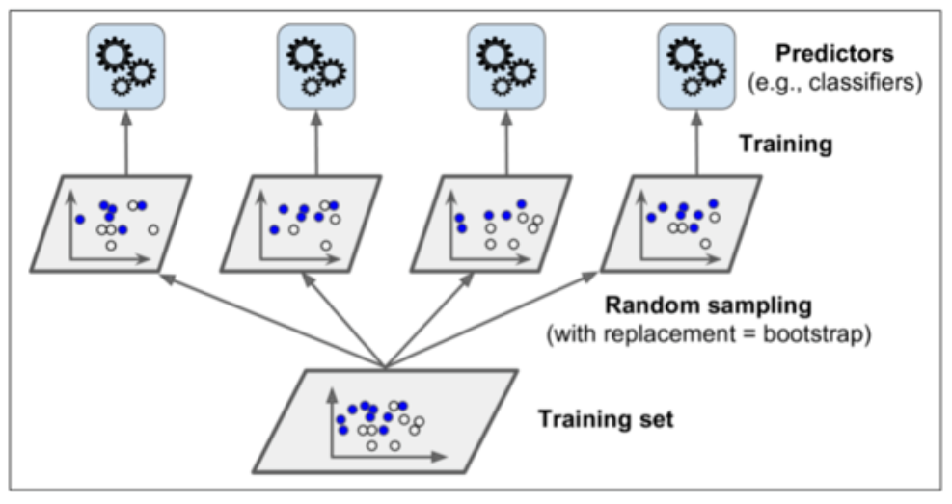
Bagging (Bootstrap Aggregation) vs. Pasting
After dividing the training data set into random pieces, the divided training data sets are assigned to several models and trained.
Bagging
  When dividing the training data set, allow overlap.
Pasting
  Do not allow overlap.

Slide 13
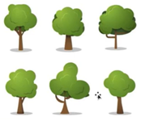
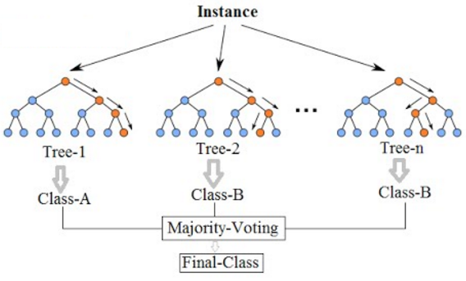
Random Forest
Create multiple decision trees and collect the results from each tree.
  When creating multiple decision trees, Bagging and boosting methods can be used.
  Use majority voting (classification) or mean (regression).

Slide 14
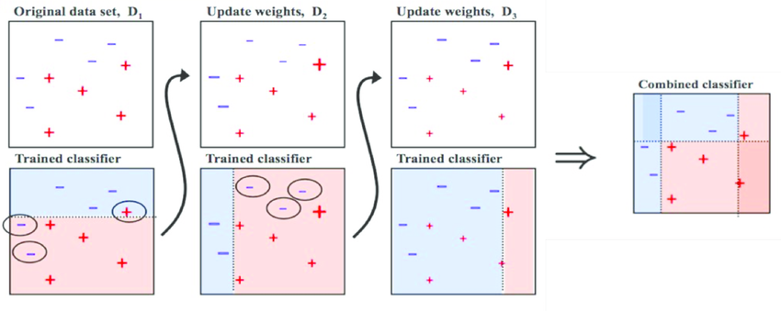
Ada boost vs. Gradient boost
Instead of combining the results of weaker models at once, the results are applied sequentially.
Ada boost (Adaptive boost)
  In the process, the weights of well-classified samples are lowered and the weights of misclassified samples are gradually increased to change the sample distribution.

Slide 15
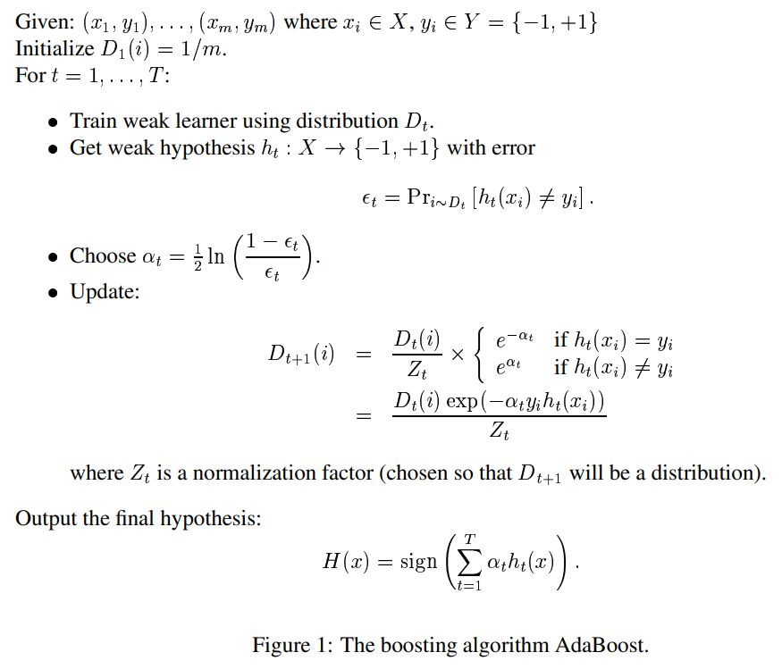

* $D_{t}(i)$ : 학습 t번째에서의 sample i의 가중치
weight update
* source : https://cseweb.ucsd.edu/~yfreund/papers/IntroToBoosting.pdf

Slide 16
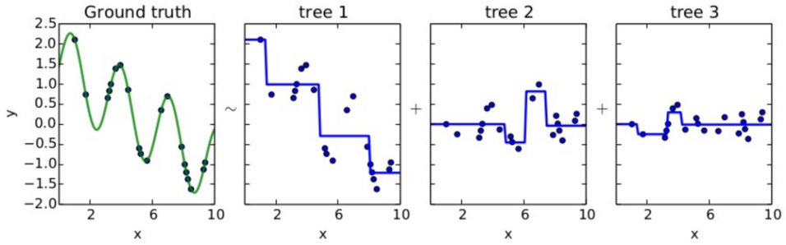
Ada boost vs. Gradient boost
Gradient boost
  In the process, optimize the error of misclassified samples.
  e.g.) Residual fitting
What should we optimize?
Notes:
* tree1에서 분류한 거리의 차(residual)를 tree2에서 y축 가운데를 기준으로 표현됨.

Slide 17

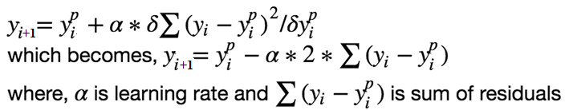
  Loss function of residual fitting
  We want our predictions, such that our loss function (MSE) is minimum. By using gradient descent and updating our predictions based on a learning rate, we can find the values where MSE is minimum.
  So, we are basically updating the predictions until the sum of our residuals is close to 0 (or minimum)
residual of i-1th classification result
Notes:
실습 프로그램을 통해 확인 필요

Slide 18
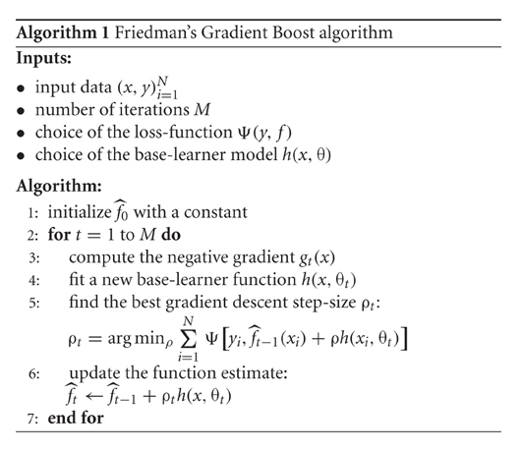

Slide 19
Aggregation vs. Boosting
 | Aggregation | Boosting
Shape | Parallel | Sequential
Purpose | Reduce variance | Reduce bias
Proper applying case | High variance & Low bias btw. models | Low variance, High bias btw. models
Representative algorithm | Random Forest | Gradient boost, Ada boost
Sampling | Random sampling | Random sampling with weight on error

Slide 20
Advantages of Ensemble
Increase overall performance by combining the results of various individual models.
Avoid the problem of overfitting.
  different models have different kinds of biases (errors), so the correlation becomes smaller.
  generate results by combining various biases lead to reduce overfitting
Mathematically, provide an extra degree of freedom.
  allow solutions that would be difficult to reach with only a single hypothesis.

Slide 21
Disadvantages of Ensemble
Not always improve performance.
Computationally expensive.
  It add learning time and memory constrains to the problem.
Lack of interpretability
  It is hard to understand when the methods are too complex.

Slide 22
Conclusion
Combining multiple learners has been a popular topic in machine learning since the early 1990s.
Recently, it has been noticed that ensembles do not always improve accuracy and research has started to focus on the criteria that a good ensemble should satisfy or how to form a good one.

Slide 23

Q & A

